Slide 1

Artificial Intelligence: Bridging Theory and Practice
Presented by: DULON AKHTER SATHEE
ID: 0562310005101018
Course Codes: CSE-06133115 (Theory), CSE-06133116 (Lab)

Slide 2

What is Artificial Intelligence?
Artificial Intelligence (AI) is a rapidly evolving field of computer science dedicated to creating intelligent agents capable of performing tasks that typically require human intellect. These tasks include learning, problem-solving, perception, and decision-making.
AI's importance in modern computing stems from its ability to automate complex processes, analyze vast datasets, and provide insights that surpass human capabilities, driving innovation across various industries.
Types of AI Agents and Environments
Agents: Simple reflex, model-based reflex, goal-based, utility-based, learning agents.
Environments: Fully observable vs. partially observable, deterministic vs. stochastic, episodic vs. sequential, static vs. dynamic, discrete vs. continuous, single-agent vs. multi-agent.

Slide 3



Core Theoretical Concepts
Human vs. Artificial Intelligence
Applications in Real-World Domains
Limitations of Current AI
Exploring the fundamental differences and similarities between human cognitive processes and algorithmic intelligence, emphasizing areas like intuition, creativity, and common sense reasoning often found lacking in AI.
Addressing inherent challenges such as data dependency, ethical concerns, lack of true understanding, and the "black box" problem, highlighting areas for future research and development.
Discussing the widespread impact of AI, from healthcare diagnostics and autonomous vehicles to natural language processing and financial modeling, showcasing its practical utility.

Slide 4

Problem Solving and Search (CLO 2)
AI problem-solving often involves finding a sequence of actions to reach a goal state from an initial state. This journey is navigated through a defined state space, where each state represents a configuration of the problem.
Uninformed Search Algorithms
BFS (Breadth-First Search): Explores all nodes at the present depth level before moving on to nodes at the next depth level.
Production systems define the rules for transitioning between these states, forming the backbone of automated problem-solving.
DFS (Depth-First Search): Explores as far as possible along each branch before backtracking.
UCS (Uniform Cost Search): Expands the node with the lowest path cost from the start node, useful for finding optimal paths.
IDS (Iterative Deepening Search): Combines the benefits of DFS (memory efficiency) and BFS (completeness, optimality for unit-cost paths).
Heuristic Search
A* Search Algorithm: An informed search algorithm that uses a heuristic function to estimate the cost from the current state to the goal, efficiently guiding the search towards an optimal solution.

Slide 5
Local Search & Optimization
Hill Climbing
Simulated Annealing
Genetic Algorithms
A simple optimization algorithm that iteratively moves in the direction of increasing value, reaching a local optimum. It's akin to climbing a hill in fog, always choosing the steepest path upwards.
Inspired by the annealing process in metallurgy, this algorithm allows occasional "bad" moves to escape local optima, gradually reducing the probability of accepting worse solutions over time to find a near-optimal global solution.
Mimicking natural selection, GAs evolve a population of potential solutions through processes like mutation, crossover, and selection to find optimal or near-optimal solutions for complex problems, particularly in combinatorial optimization.
These algorithms are crucial in various optimization problems, from circuit design and scheduling to protein folding and financial modeling, where finding the absolute best solution is computationally infeasible or undesirable.

Slide 6

Game Playing and Constraint Satisfaction Problems
Minimax and Alpha-Beta Pruning
Constraint Satisfaction Problems (CSPs)
In game theory, Minimax is a decision rule used to minimize the possible loss for a worst-case (maximum loss) scenario. It's often employed in two-player, zero-sum games like chess or tic-tac-toe, where players take turns.
CSPs involve finding a state that satisfies a given set of constraints. They are defined by variables, domains for each variable, and a set of constraints restricting the values that the variables can simultaneously take.
Alpha-Beta Pruning is an optimization technique for Minimax, which eliminates branches from the search tree that cannot possibly influence the final decision, significantly speeding up the algorithm.
Backtracking search is a common algorithm for solving CSPs. It systematically tries to extend a partial solution by attempting to assign a value to a variable, and retracting if a constraint is violated.
Examples:
Tic Tac Toe AI: Using Minimax to determine optimal moves.
Map Coloring: Assigning colors to regions on a map such that adjacent regions have different colors, a classic CSP example.

Slide 7




Knowledge Representation & Reasoning
Propositional Logic
First-Order Logic (FOL)
Bayesian Reasoning
A foundational logical system where statements (propositions) are treated as atomic units that are either true or false. Used for representing simple facts and their relationships, forming the basis for rule-based systems.
Extends propositional logic by allowing quantification over individuals and properties, enabling more complex and expressive knowledge representation, essential for describing objects, relations, and universal truths.
A probabilistic approach to reasoning under uncertainty, based on Bayes' Theorem. It allows for updating beliefs about an event given new evidence, widely used in diagnostic systems, spam filters, and medical expert systems.
These methods are critical for building intelligent systems that can understand, infer, and make decisions based on explicit and implicit knowledge, crucial for applications in expert systems, natural language understanding, and automated planning.

Slide 8
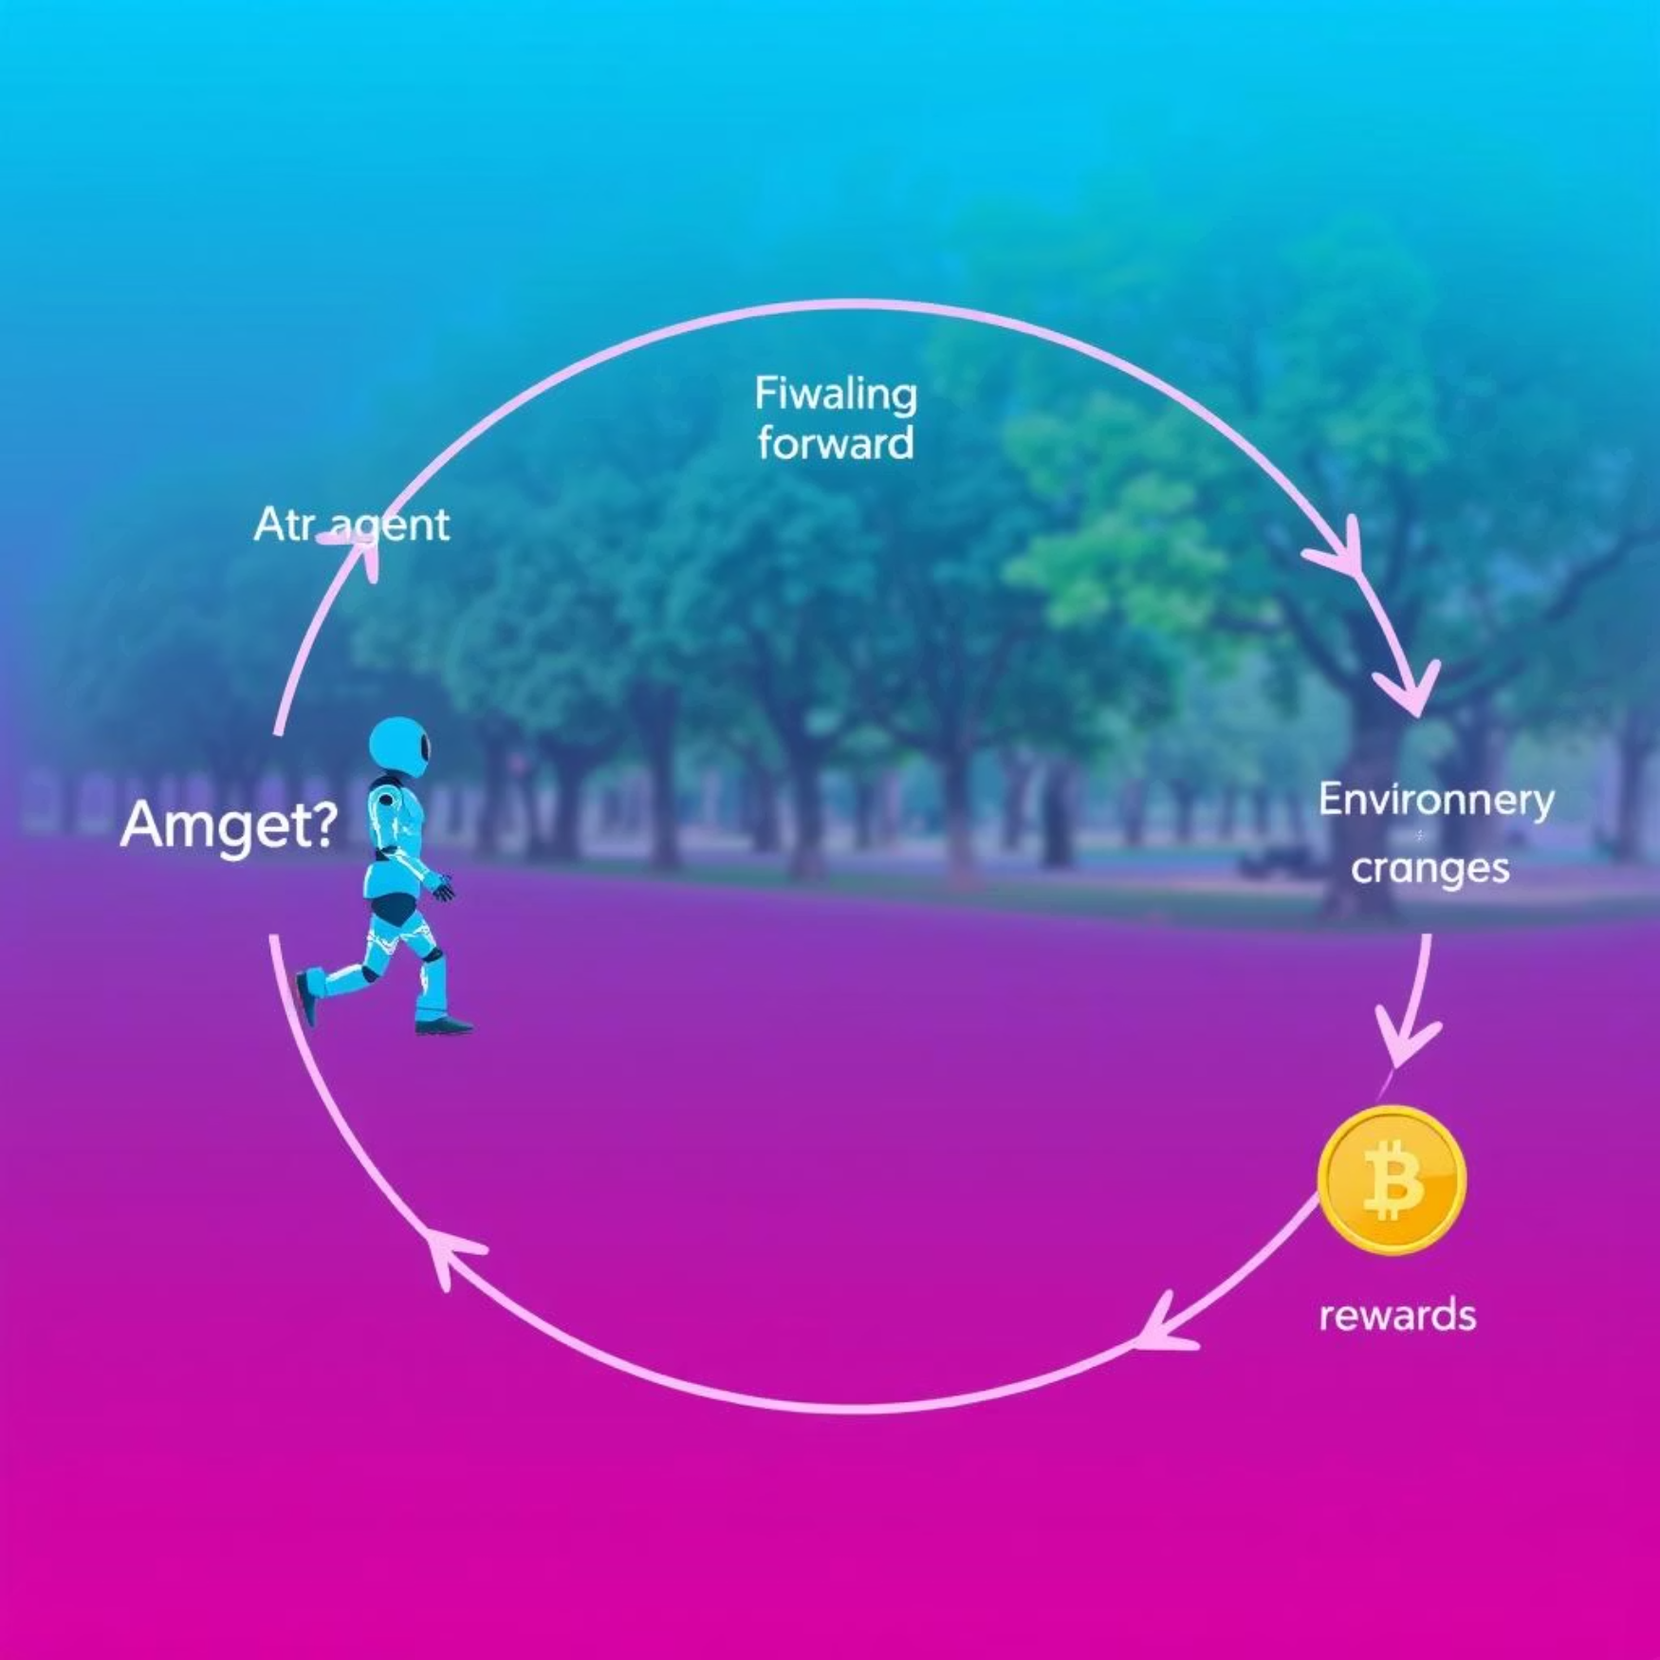
Reinforcement Learning
Reinforcement Learning (RL) is a paradigm of machine learning where an agent learns to make decisions by performing actions in an environment to maximize a cumulative reward. It operates on the principle of trial and error, without explicit programming for every possible scenario.
Key Concepts:
Bellman Equation: A fundamental equation in dynamic programming that describes the value of a decision problem at a certain point in time in terms of the value at previous points in time. It helps to calculate the optimal policy by relating the value of a state to the values of its successor states.
The agent observes the environment's state, takes an action, receives a reward (or penalty), and transitions to a new state. This feedback loop allows the agent to refine its policy over time.
Value Iteration: An algorithm that iteratively updates the value function for each state until it converges to the optimal value function, which then defines the optimal policy.
Policy Iteration: An alternative algorithm that alternates between policy evaluation (estimating the value function for the current policy) and policy improvement (updating the policy based on the evaluated value function).
Applications:
Game Playing: Mastering complex games like Go and Chess.
Robotics: Training robots for navigation, manipulation, and control tasks.
Resource Management: Optimizing energy consumption and supply chain logistics.

Slide 9
Lab Work Highlights
Our practical sessions provided hands-on experience, bridging theoretical knowledge with real-world implementation using Python. The focus was on building foundational AI algorithms from scratch.
Python-based Implementation: All algorithms were developed using Python, leveraging its extensive libraries for AI and data science.
Search Algorithms: Implemented and compared the performance of Breadth-First Search (BFS), Depth-First Search (DFS), and A* Search in various problem domains, such as pathfinding and puzzle solving.
Constraint Satisfaction Problems (CSPs): Developed solvers for CSPs, applying backtracking and heuristic techniques to solve classic problems like N-Queens and Sudoku.
Minimax Game AI: Designed and implemented AI agents for two-player games (e.g., Tic Tac Toe, Chess), incorporating the Minimax algorithm with Alpha-Beta Pruning for optimal decision-making.
Reinforcement Learning Simulations: Conducted simulations to understand RL concepts, exploring Q-learning and SARSA algorithms in simplified environments like Grid World to observe agent learning behavior.

Slide 10
Sample Lab Projects
AI in Games: Minimax with Alpha-Beta Pruning
CSP Solver: “TWO + TWO = FOUR”
Developed an intelligent agent for a game like Tic Tac Toe, demonstrating optimal play by employing the Minimax algorithm enhanced with Alpha-Beta Pruning to efficiently explore the game tree.
Implemented a Constraint Satisfaction Problem solver to find numerical assignments for the classic cryptarithmetic puzzle "TWO + TWO = FOUR," showcasing the application of backtracking search and constraint propagation.
Optimization: Simulated Annealing on TSP
Reinforcement Learning with Grid World
Applied Simulated Annealing to solve instances of the Traveling Salesperson Problem (TSP), illustrating how local search techniques can find near-optimal solutions for NP-hard optimization problems.
Created an RL agent that learns to navigate a Grid World environment to reach a target while avoiding obstacles, using Q-learning to discover an optimal policy through iterative interaction and reward feedback.

